Slide 1
COSI should get a vacuum cleaner
By Sophia (given to Sydney (given to David))

Slide 2
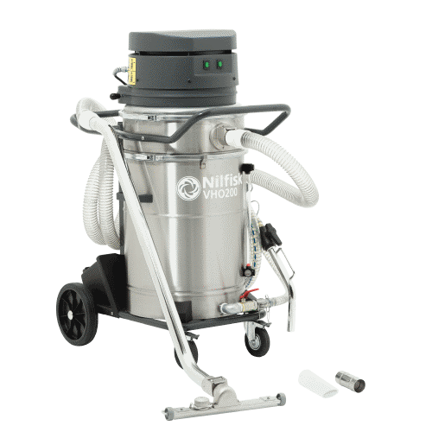
What is a vacuum Cleaner?
A vacuum cleaner, also known simply as a vacuum or a hoover, is a device that causes suction in order to remove dirt from floors, upholstery, draperies, and other surfaces. It is generally electrically driven.
The dirt is collected by either a dustbag or a cyclone for later disposal.
Vacuum cleaners, which are used in homes as well as in industry, exist in a variety of sizes and models—small battery-powered hand-held devices, wheeled canister models for home use, domestic central vacuum cleaners, huge stationary industrial appliances that can handle several hundred litres of dust before being emptied, and self-propelled vacuum trucks for recovery of large spills or removal of contaminated soil. Specialized shop vacuums can be used to suck up both dust and liquids.

Slide 3

The absolute state of COSI
-Dirty
-Unclean:
-Needs a vacuum

Slide 4
Why COSI should get a vacuum cleaner
-Due to the nature of vacuum cleaners, getting a vacuum cleaner would help make the room cleaner
-We could brag to other rooms
-they look cool.

Slide 5
Thank uou
Pls get a vacuum cleaner

